Slide 1
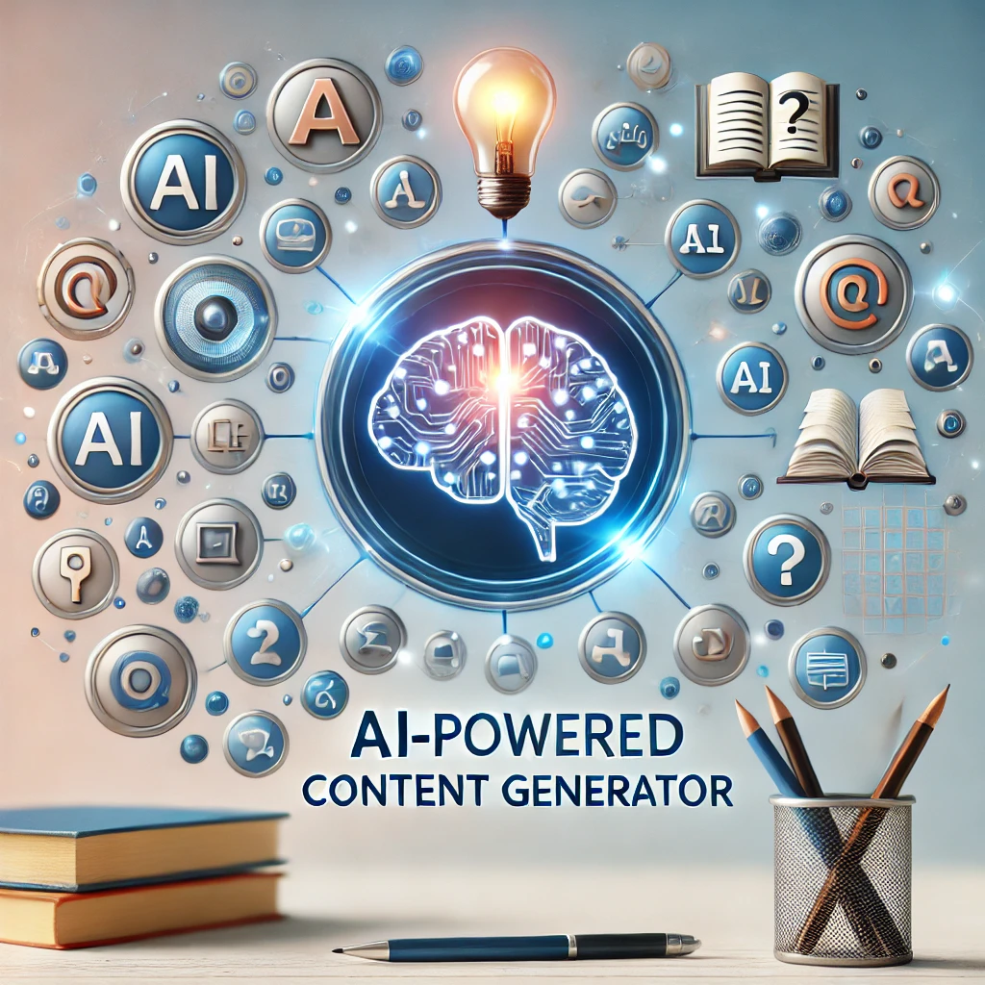

AI –POWERED CONTENT GENERATOR FOR EDUCATIONAL INSTITUTIONS

Slide 2




Project Leadership
Sharat Manikonda
Director at Innodatatics and Sponsor
linkedin.com/in/sharat-chandra
Aditha Dhillon
Project Guide

Slide 3

Contents
Business objective
Business Constraints
Project Architecture
Data collection and details
Exploratory Data Analysis
Visualization
Modeling
Evaluation
Deployment
Notes:
Change

Slide 4
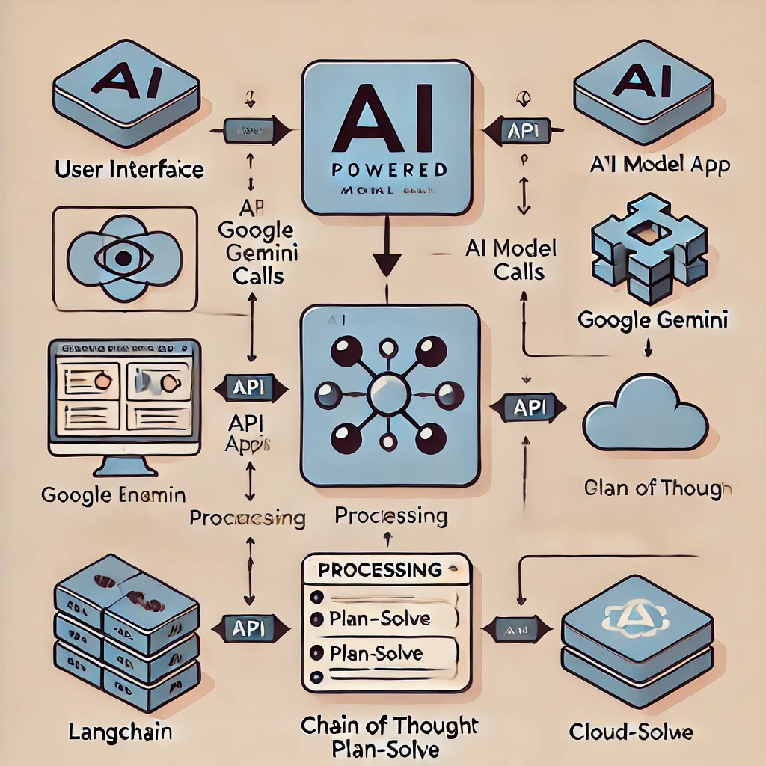
Project Overview and Architecture
User Interface: The Streamlit app serves as the frontend where users input the topic and number of questions.
API Integration: The app calls the Google Gemini API to generate questions and answers using AI.
Processing: LangChain applies Chain of Thought and Plan-Solve prompt techniques to generate well-structured questions and answers.
Cloud Deployment(future scope): The entire application is hosted in the cloud, enabling scalability and reliability.

Slide 5
Business Problem
ON DEMAND GENERATION OF CONTENT FOR A WIDE VARIETY OF COURSES OFFERED BY THE UNIVERSITY .DUE TO HIGH DEMAND FOR SUCH QUESTIONS ,CREATING THEM MANUALLY BECOMES DIFFICULT

Slide 6
Business Objective
Objective
Constraints
MINIMIZING PLAGIARISM OF CONTENT
to MAXIMIZE CONTENT GENERATION QUALITY AND MINIMIZE TIME TAKEN

Slide 7
CRISP-ML(Q) Methodology
There are six stages of CRISP-ML(Q) Methodology
1.Business and data understanding
2.Data preparation
3.model building
4.Model evaluation
5.Model deployment
6.Monitoring and maintenance

Slide 8
Technical Stacks
Programming Languages
Python
Deployment
Streamlit
Api Model
Gemini 1.5-flash
Langchain
Optimization
Prompt techniques

Slide 9
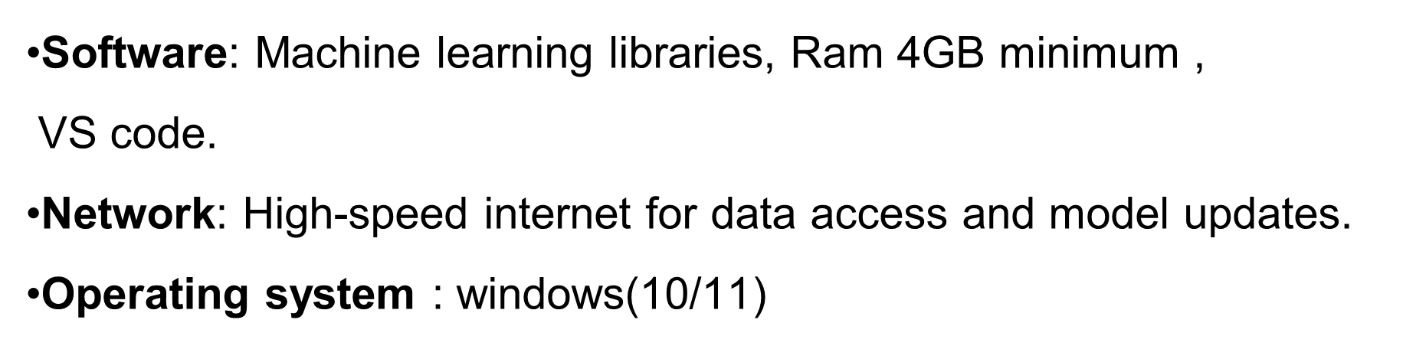
System Requirements

Slide 10
Model Building
Algorithm Selection: Experiment with different machine learning algorithms like GPT, GEMINI, or transformers for content generation and plagiarism detection.
Model Training: Train the selected models with different prompt techniques for optimal performance.
Notes:
classification is the task of predicting a discrete class label. Regression is the task of predicting a continuous quantity.
What is classification techniques in machine learning?
The Classification algorithm is a Supervised Learning technique that is used to identify the category of new observations on the basis of training data. In Classification, a program learns from the given dataset or observations and then classifies new observation into several classes or groups.
What is regression techniques in machine learning?
Regression is a technique for investigating the relationship between independent variables or features and a dependent variable or outcome. It's used as a method for predictive modeling in machine learning, in which an algorithm is used to predict continuous outcomes.

Slide 11
Model Accuracy Comparison
Throughout the project we tested different prompt techniques and chose
the best prompt techniques to produce better results
To decide the best prompt technique we focused on following points
Content Complexity: The techniques should be able to handle the complexity of the subject matter, ensuring that the generated questions and answers reflect depth and accuracy, which is essential for university-level educational content.
Question Structure: The prompt techniques should promote logical and well-structured outputs, making sure that questions are clear, unique, and challenge the learner's understanding without ambiguity or redundancy.
Answer Detail: The chosen techniques should enable the generation of detailed and comprehensive answers, especially for short and long-answer questions, ensuring the responses provide meaningful insights and enhance the learning experience.

Slide 12
Best Model –
Among all the prompt techniques we decided that CoT(chain of thought) and plan-solve prompt techniques to be the best prompt techniques
Purpose: By combining CoT and Plan-Solve techniques, you cover both the question-generation aspect (CoT) and the answer-generation aspect (Plan-Solve), ensuring that both parts are handled with depth and precision.
Benefit: This combination allows for the generation of high-quality questions and answers that require logical thinking, problem-solving, and a deep understanding of the topic. It minimizes the risk of repetitive or shallow questions.
For university-level content, where critical thinking and detailed understanding are paramount, this approach helps in creating content that challenges students and promotes learning effectively.
Notes:
Why Random Forest Regression is good?
A Random Forest Regression model is powerful and accurate. It usually performs great on many problems, including features with non-linear relationships
How is XGBoost different from random forest?
One of the most important differences between XG Boost and Random forest is that the XGBoost always gives more importance to functional space when reducing the cost of a model while Random Forest tries to give more preferences to hyperparameters to optimize the model..
n_estimators — the number of decision trees you will be running in the model

Slide 13
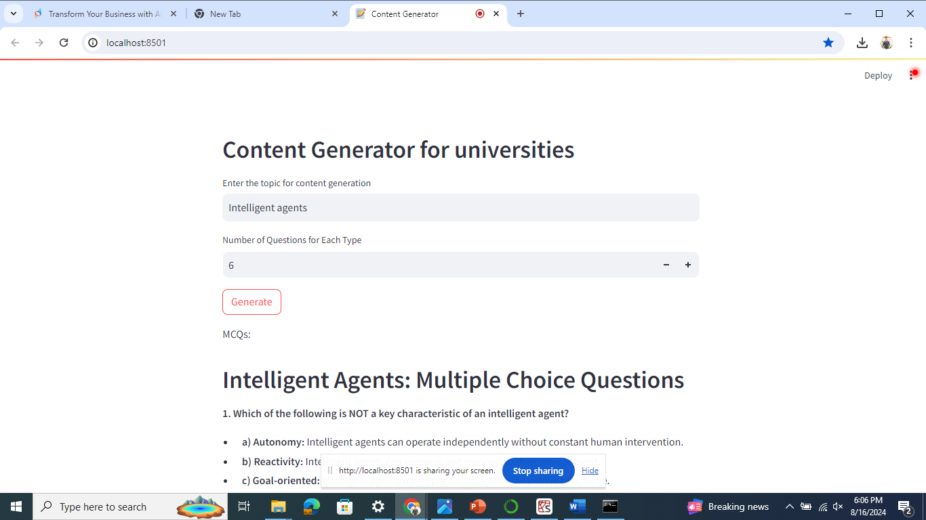
Screen shot of output

Slide 14
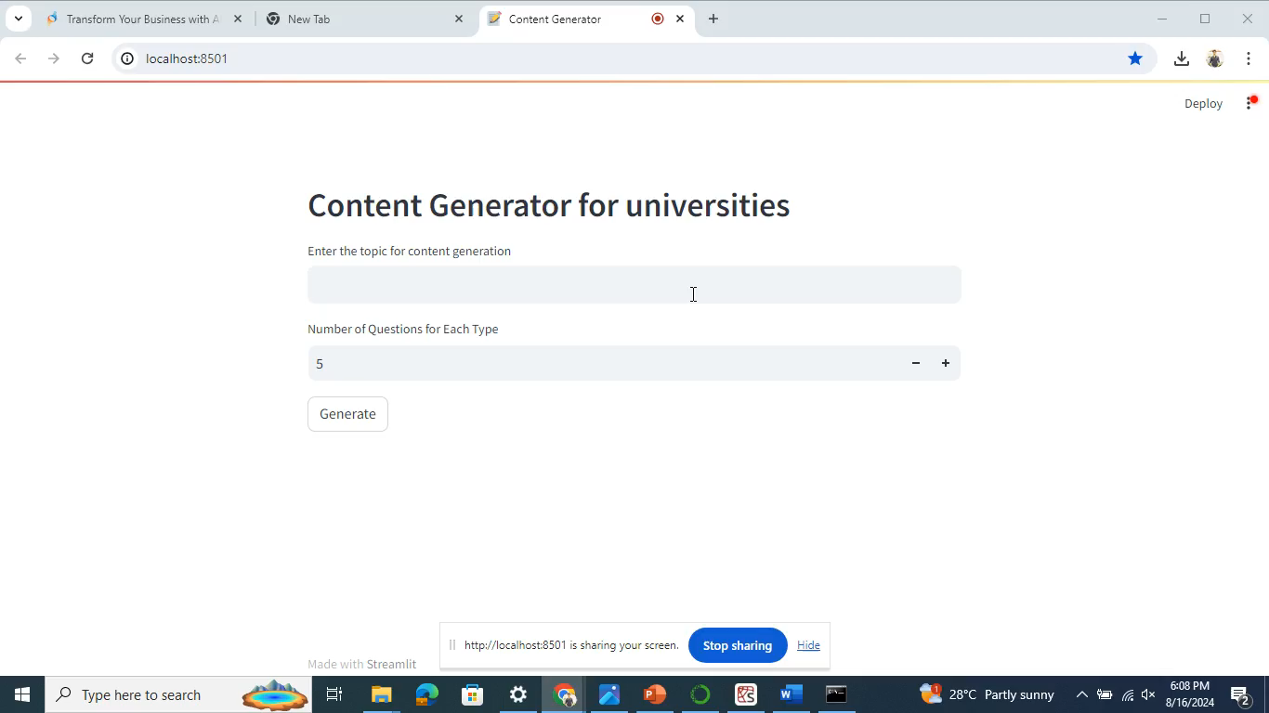
Video of output

Slide 15
Challenges
Ensuring that the generated questions and answers are unique and non-repetitive can be challenging. Even with Chain of Thought and Plan-Solve techniques, fine-tuning prompts to consistently produce diverse content without redundancy requires careful experimentation and iteration
Achieving a balance between generating high-quality, detailed questions and answers and maintaining fast response times is critical, especially when dealing with complex topics and multiple users. Optimizing model parameters (e.g., temperature) and handling rate limits efficiently can be tricky
As the application grows, managing simultaneous requests without performance degradation can be challenging. Ensuring that the deployment infrastructure scales effectively and handles high volumes of concurrent users requires robust cloud-based strategies and efficient load balancing

Slide 16
Future Scopes
Personalized Content Generation: Implement adaptive learning features by generating tailored questions based on a user's performance and knowledge level, allowing for more personalized educational experiences.
Multi-language Support: Expand the project to support multiple languages, enabling content generation for a global audience and catering to diverse educational needs across different regions.
Integration with Learning Management Systems (LMS): Integrate the project with popular LMS platforms (e.g., Moodle, Canvas) to streamline the creation of quizzes, assignments, and learning materials directly within existing educational ecosystems.

Slide 17

Queries ?

Slide 18


